Slide 1

ML, AI and Data Science
Dr. Rakhee Chhibber

Slide 2
AGENDA
Introduction to AI, ML and its relationship with Data Science
Steps to build ML Project
Types and use of Data in ML projects
ML Platforms and their desired features

Slide 3
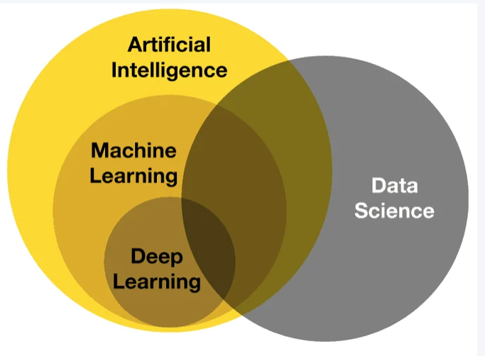
Introduction to AI, ML and its relationship with Data Science
Data Science is an interdisciplinary field leveraging AI and ML to extract insights from data, with ML providing the predictive tools and AI offering the autonomous decision-making capabilities.

Slide 4
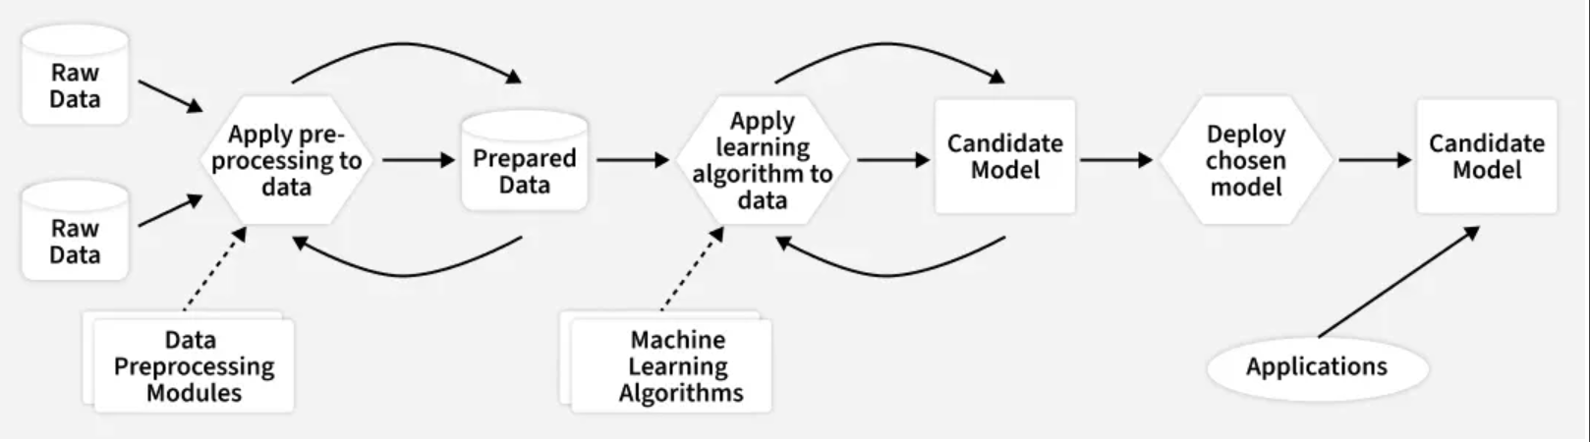
Steps to Build a Machine Learning Model

Slide 5
Why Machine Learning is Important?
Automation: Eliminates manual and repetitive tasks using intelligent systems.
Prediction and Forecasting: Enables accurate decision-making through data-driven predictions.
Real time Insights: Detects patterns instantly for use cases like fraud detection.
Personalization: Delivers user-specific recommendations by learning individual preferences.
Efficiency and Optimization: Enhances performance, reduces errors and lowers operational costs.

Slide 6
How to Build a Machine Learning Model
1. Define the Problem
2. Collect Data
3. Data Cleaning and Preprocessing
4. Exploratory Data Analysis (EDA)
5. Feature Selection and Engineering
6. Split Data into Training and Testing Sets
7. Select a Machine Learning Algorithm
8. Train the Model
9. Evaluate Model Performance
10. Hyperparameter Tuning
11. Deploy the Model
12. Monitor and Maintain the Model

Slide 7
1. Define the Problem
Clearly understand what the model is supposed to predict or classify, ensuring the ML task matches the actual objective.
Identify the business goal or research purpose behind building the model.
Decide whether the task is regression, classification, clustering or forecasting.
Determine the type of data required and the expected output format.

Slide 8
2. Collect Data
Collect all relevant and high quality data from reliable sources, as the dataset forms the foundation of any machine learning model.
Gather data from databases, sensors, surveys, web APIs or public datasets like Kaggle and UCI.
Ensure the dataset is large, clean and representative of the real problem.
Combine data from multiple sources if needed to improve coverage and diversity.
Check early for issues like missing values, noise and imbalance to avoid problems later.

Slide 9
3. Data Cleaning and Preprocessing
Prepare the raw data for modeling by fixing errors, handling missing values and transforming it into a clean and usable form.
Remove duplicates and correct inconsistent or incorrect entries.
Handle missing values using imputation, deletion or interpolation techniques.
Normalize or scale numerical features for stable and faster model training.
Encode categorical variables using Label Encoding, One-Hot Encoding or Target Encoding.

Slide 10
4. Exploratory Data Analysis (EDA)
Analyze the dataset to understand patterns, distributions and relationships between features before building the model.
Visualize data using graphs, charts, heatmaps and pair plots.
Check statistical summaries to understand mean, variance, skewness and outliers.
Study feature relationships and correlations to identify useful predictors.
Detect anomalies, trends and hidden patterns that influence model design.

Slide 11
5. Feature Selection and Engineering
Select the most relevant features and create new meaningful ones to enhance model accuracy, reduce complexity and improve learning.
Remove irrelevant, redundant or noisy features that harm performance.
Use techniques like Correlation Analysis, Chi-square, ANOVA, PCA, Mutual Information.
Good feature engineering often improves performance more than switching algorithms.

Slide 12
6. Split Data into Training and Testing Sets
Divide the dataset so the model learns from one part and is evaluated fairly on unseen data.
Ensures the model is evaluated on unseen data, preventing overfitting.
Stratified splits are used for classification to maintain class balance.
Optionally create a validation set or use cross validation for better tuning.

Slide 13
7. Select a Machine Learning Algorithm
Choose the most suitable algorithm based on the problem type, data characteristics, and performance requirements.
Pick algorithms depending on the task like Linear Regression, Random Forest, SVM, KNN, Neural Networks.
Consider factors like speed, accuracy, interpretability, scalability and dataset size.
For smaller datasets, simpler models often perform better large datasets may benefit from deep learning

Slide 14
8. Train the Model
Train the selected algorithm on the prepared training data so it can learn patterns, relationships and decision boundaries
Adjust model parameters iteratively to minimize loss.
Monitor learning curves to track training progress and detect issues early.
Ensure the model converges properly and is not overfitting or diverging.

Slide 15
9. Evaluate Model Performance
Test the trained model on unseen data to measure how well it generalizes and how reliable its predictions are.
Use metrics like Accuracy, Precision, Recall, F1-score, RMSE, MAE, R² depending on task type.
Compare training vs testing results to detect overfitting or underfitting.
Use confusion matrices, ROC curves and error analysis for deeper evaluation.

Slide 16
10. Hyperparameter Tuning
Optimize the model’s hyperparameters to achieve higher accuracy, stability and better generalization.
Use Grid Search, Random Search, Bayesian Optimization or cross-validation techniques.
Adjust settings like learning rate, depth, number of trees, batch size, etc.
Aim to balance model complexity vs performance to avoid overfitting.

Slide 17
11. Deploy the Model
Make the trained model available for real-world use by integrating it into applications, systems or services.
Deploy on cloud platforms or mobile systems.
Set up APIs, model servers or pipelines using Flask, FastAPI, TensorFlow Serving or Docker.
Monitor model performance in production to detect drift or degradation.

Slide 18
12. Monitor and Maintain the Model
Continuously track the model’s performance in production and update it when real-world data or patterns start to change.
Retrain the model with new or updated data whenever accuracy declines.
Detect data drift, concept drift or model degradation using monitoring tools.
Log predictions, errors and feedback to identify issues early.
Regular maintenance ensures the model remains reliable, accurate and relevant over time.

Slide 19
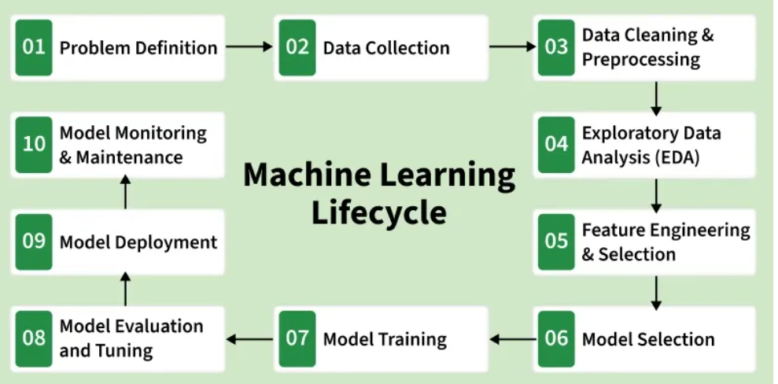

Slide 20
Common Terms Used in Machine Learning
Features: Input variables or attributes used by the model to make predictions can be numerical, categorical
Labels: The target variable that the model tries to predict during supervised learning.
Training Set: Dataset used to teach the model patterns and relationships between features and labels.
Validation Set: A separate dataset used for tuning hyperparameters and preventing overfitting during model development.
Test Set: Final dataset used to check how well the trained model generalizes to unseen data.
Overfitting: A condition where the model memorizes training data but fails on new data hence solved using regularization, dropout and cross-validation.
Underfitting: Occurs when the model is too simple to learn underlying patterns, resulting in poor performance on both training and test data.
EDA (Exploratory Data Analysis): Process of visualizing, summarizing and understanding data distributions, outliers and relationships before modeling.
Hyperparameters: Model settings defined before training like learning rate, number of trees, batch size, etc that significantly affect model performance.
Cross-Validation: Technique to evaluate model performance by splitting data into multiple folds, ensuring stable and reliable accuracy.
Feature Engineering: Process of creating, transforming or selecting meaningful features to improve model learning and accuracy.
Model Deployment: Making a trained model usable in real applications through APIs, cloud platforms or integration into software systems.

Slide 21
Types of Data in ML Project- by structure
Structured Data: Highly organized data formatted in fixed fields within records or files, typically stored in relational databases or spreadsheets (e.g., SQL databases). It is easily searchable and used in traditional ML algorithms like regression.
Unstructured Data: Data that lacks a predefined schema or format, such as free-form text, images, audio files, and videos. This type makes up the majority of the data in the world and requires advanced techniques like deep learning or natural language processing (NLP) to process.
Semi-structured Data: A form that does not conform to the formal structure of a relational database but contains tags and markers to enforce a hierarchy of records (e.g., JSON or XML files).

Slide 22
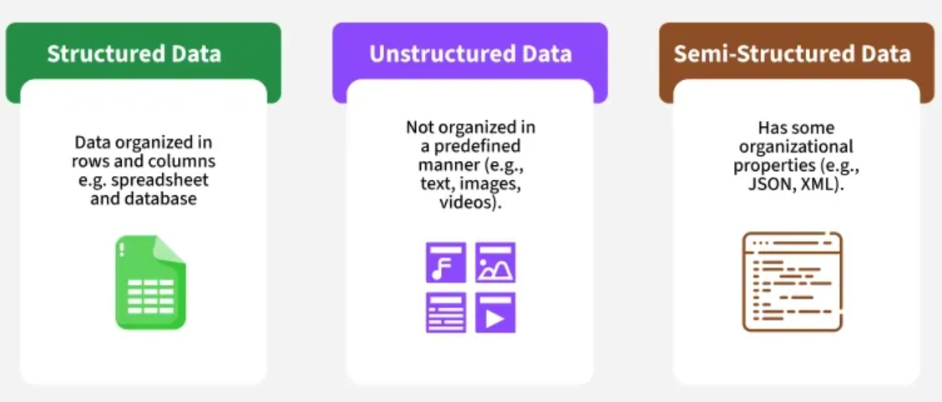

Slide 23
Data type - By Type/Nature
Numerical Data: Represents measurable quantities.
  Discrete: Data that can only take on a finite number of values (e.g., number of rooms in a house).
  Continuous: Data that can take any value within a given range (e.g., temperature or price).
Categorical Data: Represents characteristics or groups (e.g., gender, product type, or city) which can be converted to a numerical format using techniques like one-hot encoding for use in ML models.
Time Series Data: Data points indexed or listed in time order, used for tracking trends and forecasting (e.g., stock prices).
Text Data: Words, sentences, and paragraphs used for sentiment analysis, language modeling, and classification tasks through NLP techniques.
Image/Audio Data: Raw pixel values for images or wave signals for audio, processed by computer vision and speech recognition models, respectively.

Slide 24
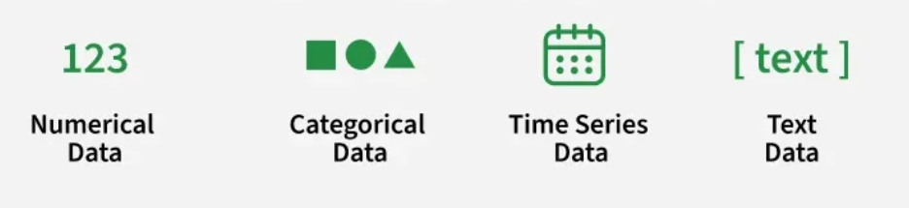

Slide 25
ML Tools
Microsoft Azure Machine Learning
Amazon SageMaker
BigML
TensorFlow
PyTorch
Apache Mahout
Weka
Vertex AI

Slide 26
Statistics in Data Science

Slide 27
Statistics For Data Science
Statistics is the science of collecting, analyzing, and interpreting data to uncover patterns and make decisions. In data science, it acts as the backbone for understanding data and building reliable models.
Summarizes data using measures like mean, median, and variance
Models uncertainty with probability and distributions
Tests hypotheses (e.g., A/B testing)
Finds relationships through regression and correlation

Slide 28
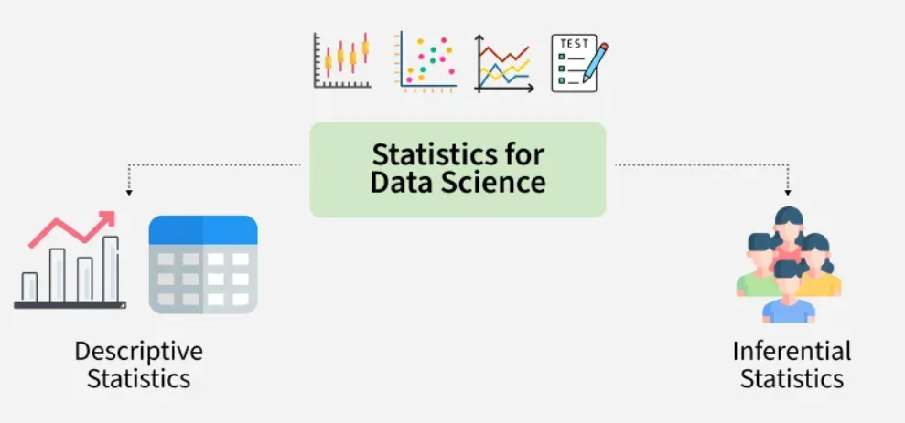
Descriptive Statistics: De­scriptive Statistics helps us simplify and organize big chunks of data. This makes large amounts of data easier to understand.
Inferential Statistics: Inferential Statistics is a little different. It uses smaller data to conclude a larger group. It helps us predict and draw conclusions about a population.

Slide 29
Data in Statistics?
Types of Data
1. Qualitative Data: This data is descriptive. For example - She is beautiful, He is tall, etc.
2. Quantitative Data: This is numerical information. For example- A horse has four legs.
  Discrete Data: It has a particular fixed value and can be counted.
  Continuous Data: It is not fixed but has a range of data and can be measured.

Slide 30
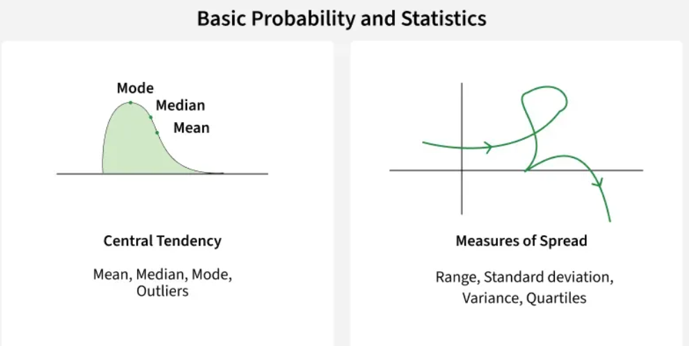

Slide 31
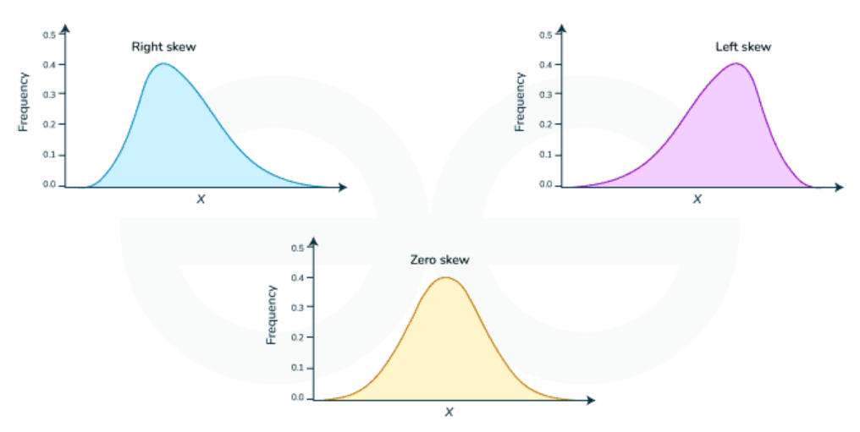
Measure of Shape
Skewness
Types of Skewed data
  Positive Skew (Right): Mean > Median
  Negative Skew (Left): Mean < Median
  Symmetrical: Mean = Median

Slide 32
Python Statistics Libraries
NumPy is a third-party library for numerical computing, optimized for working with single- and multi-dimensional arrays. Its primary type is the array type called ndarray. This library contains many routines for statistical analysis.
SciPy is a third-party library for scientific computing based on NumPy. It offers additional functionality compared to NumPy, including scipy.stats for statistical analysis.
pandas is a third-party library for numerical computing based on NumPy. It excels in handling labeled one-dimensional (1D) data with Series objects and two-dimensional (2D) data with DataFrame objects.
Matplotlib is a third-party library for data visualization. It works well in combination with NumPy, SciPy, and pandas.

Slide 33
Calculating Descriptive Statistics
import math
import statistics
import numpy as np
import scipy.stats
import pandas as pd
x = [8.0, 1, 2.5, 4, 28.0]
x_with_nan = [8.0, 1, 2.5, math.nan, 4, 28.0]
x
x_with_nan

